Slide 1
Analysis of Dow Jones Industrial Average
Mushka Liberow
Baruch College
Spring 2020
Citation
Samuel H. Williamson, "Daily Closing Values of the DJA in the United States, 1885 to Present,“ MeasuringWorth, 2020 URL: http://www.measuringworth.com/DJA/

Slide 2
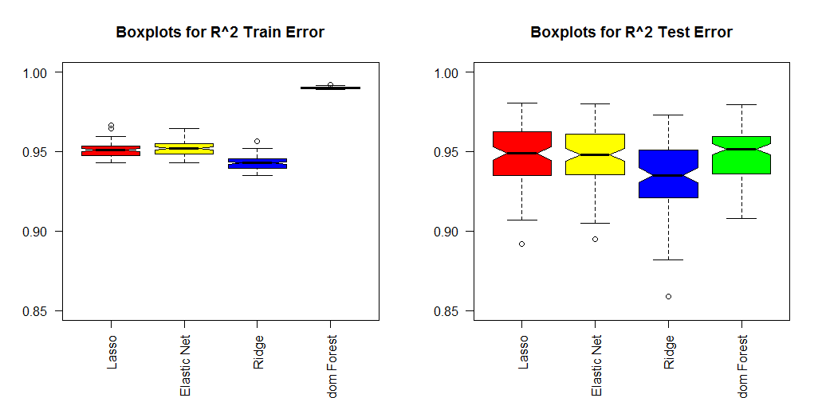

Slide 3
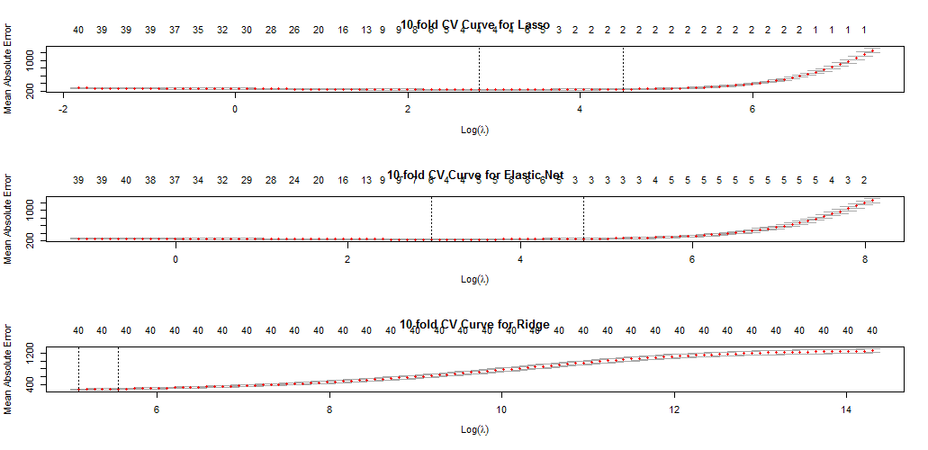

Slide 4
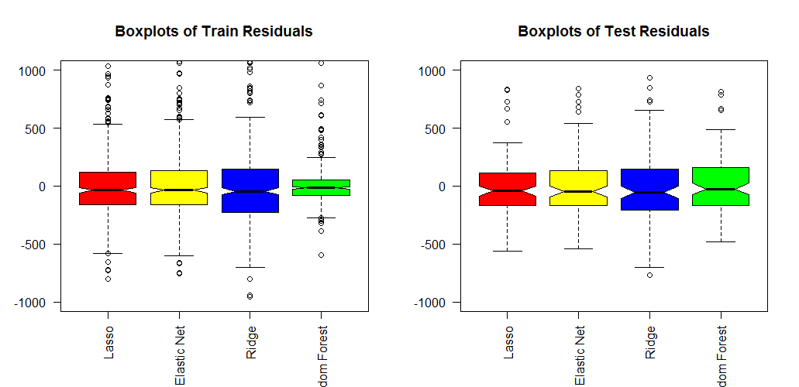

Slide 5
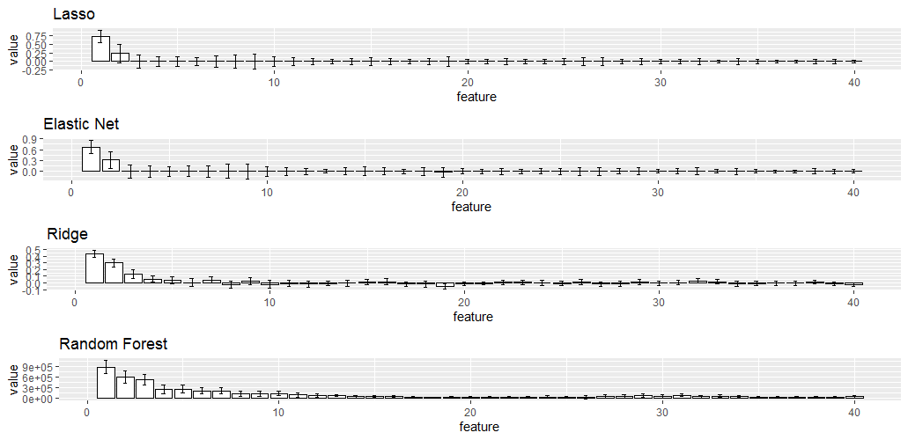
Estimated Importance of Coefficients Using Bootstrapped Errors

Slide 6
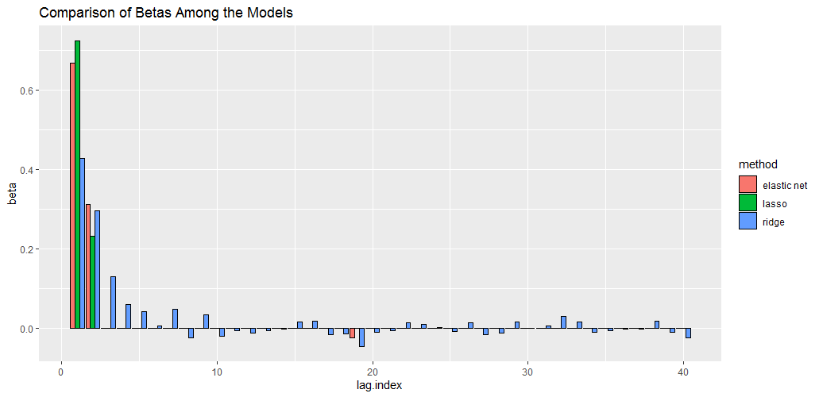

Slide 7
Summary of Run Time
Lasso | 0.1538689
Elastic Net | 0.1508386
Ridge | 0.1316075
Random Forest | 1.309195
Summary of Performance
Boxplots of R^2 Errors | Random Forest preforms best on train data, but is only slightly better than Lasso and Elastic net on test data.
Number of Predictors Used in each Model, and Their Estimated Importance | Lasso and Elastic Net primarily use the first two predictors with almost the same weights, Ridge uses all forty, and Random Forest uses most, giving highest importance to the first four and somewhat less to the others.
Boxplots of Residuals | Random Forest outperforms all models on the train data, but nearly tie with Lasso and Elastic Net on test data.
Run Time | Lasso, Elastic Net and Ridge have comparably short run times.

